Slide 1
Tenors and Tensor Ops

Slide 2
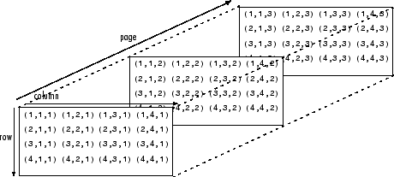
So, what did we learn about Tensors?
Tensors are simply arrays of numbers eg. [3] of [3,2,3]. Both are arrays of 1 dimension.
A 1 Dim. tensor is a vector, e.g [3] or [3,2] (Rank 1 Tensor)
A 2 dim. Tensor e.g [3 2
2 1] is called a matrix (Rank 2 Tensor)
A 3 dim. Tensor
Is called a Triad. (Rank 3 Tensor)

Slide 3
Vector Transformations
We know vectors can be multiplied by scalars to produce new vectors with the same direction. In general, we can specify a unit vector u, at any location we wish, to point in any direction we please. In order to construct another vector from the unit vector, we multiply u by a scalar, for example λ, to obtain λu, a new vector with magnitude λ and the direction of u.
The unit vector by the scalar is to change the magnitude from unity to something else, but to leave the direction unchanged. Suppose we wished to alter both the magnitude and the direction of a given vector. Multiplication by a scalar is no longer sufficient.
If we form the dot product of a vector and a tensor of rank 2,a matrix, the result will be another vector with both a new magnitude and a new direction.

Slide 4
Tensor Transformations and Deep Learning
We know what Tensors are now, arrays of numbers in n dimensions. We also know that in machine learning our fundamental data type, a dataframe, was a Tensor of Rank 2. So, Tensors have always been the data representations in machine learning.
If this is the case, why is deep learning special? Well, even in the Tensor of Rank 2 case we are doing something different since we are passing our input data through successive layers, transformed by weights that change the representation of data in some manner, getting an ouput and adjusting the weights or representation in order to reduce our error. Even here, each time we are performing operations on Rank 2 Tensors and producing new ones.

Slide 5
Another take on Neural Networks
You just learned that neural networks consist entirely of chains of tensor operations and that all of these tensor operations are just geometric transformations of the input data. It follows that you can interpret a neural network as a very complex geometric transformation in a high-dimensional space, implemented via a long series of simple steps.
Now lets look at some concrete examples of data tensors

Slide 6
Examples of data tensors
Vector data—2D tensors of shape(samples,features)
Timeseries data or sequence data—3D tensors of shape (samples, timesteps, features)
Images—4D tensors of shape(samples,height,width,channels)
Video —5D tensors of shape (samples, frames, height, width, channels)
So, what do these representations of data actually look like?

Slide 7
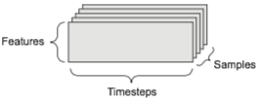
Time - Series Data
Example - Every minute, we store the current price of the stock, the highest price in the past minute, and the lowest price in the past minute. Thus every minute is encoded as a 3D vector, an entire day of trading is encoded as a 2D tensor of shape (390, 3) (there are 390 minutes in a trading day), and 250 days’ worth of data can be stored in a 3D tensor of shape (250, 390,3). Here, each sample would be one day’s worth of data.
Notes:
dataset of tweets, where we encode each tweet as a sequence of 280 characters out of an alphabet of 128 unique characters. In this setting, each character can be encoded as a binary vector of size 128 (an all-zeros vector except for a 1 entry at the index corresponding to the character). Then each tweet can be encoded as a 2D tensor of shape (280, 128), and a dataset of 1 million tweets can be stored in a tensor of shape (1000000, 280, 128).

Slide 8
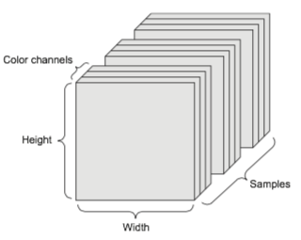
Image Data
A batch of 128 grayscale images of size 256 × 256 could thus be stored in a tensor of shape (128, 256, 256, 1), and a batch of 128 color images could be stored in a tensor of shape (128, 256, 256, 3)

Slide 9
The rare Rank 5 Tensor Video data
A video can be understood as a sequence of frames, each frame being a color image. Because each frame can be stored in a 3D tensor (height, width, color_depth), a sequence of frames can be stored in a 4D tensor (frames, height, width, color_ depth), and thus a batch of different videos can be stored in a 5D tensor of shape (samples, frames, height, width, color_depth).

Slide 10
Tensor Operations
All transformations learned by deep neural networks can be reduced to a handful of tensor operations applied to tensors of numeric data (additiona, reshaping etc.)
Here is a Naive python implementation of tensor addition
def naive_add_matrix_and_vector(x, y): assert len(x.shape) == 2 # matrix (3,5) assert len(y.shape) == 1 # vector (3,) assert x.shape[1] == y.shape[0] # (m,n) matrix + (n) vector x = x.copy() for i in range(x.shape[0]): for j in range(x.shape[1]): x[i, j] += y[j] return x

Slide 11
Tensor Operations
Tensor dot product. Of course, a dot product generalizes to tensors with an arbitrary number of axes.
def naive_vector_dot(x, y): assert len(x.shape) == 1 assert len(y.shape) == 1 assert x.shape[0] == y.shape[0] z = 0. for i in range(x.shape[0]): z += x[i] * y[i] return z

Slide 12
Tensor shape compatibility
For matricies, the rows and matrix X and the columns of Matrix Y must have the same size, it follows that the width of x must match the height of y.
You can take the dot product between higher-dimensional tensors, following the same rules for shape compatibility as outlined earlier for the 2D case: (a, b, c, d) . (d,) -> (a, b, c) (a, b, c, d) . (d, e) -> (a, b, c, e)
So, often we will need to .reshape our tensors to match a target shape.
Example, train_images = train_images.reshape((60000, 28 * 28)) since the target is a (60000,10) tensor. That is 60000 examples, 10 classes of numbers.

Slide 13
Mental Image of deep learning
Imagine two sheets of colored paper: one red and one blue. Put one on top of the other. Now crumple them together into a small ball. That crumpled paper ball is your input data, and each sheet of paper is a class of data in a classification problem. What a neural network (or any other machine-learning model) is meant to do is figure out a transformation of the paper ball that would uncrumple it, so as to make the two classes cleanly separable again.
With deep learning, this would be implemented as a series of simple transfor- mations of the 3D space, such as those you could apply on the paper ball with your fin- gers, one movement at a time

Slide 14
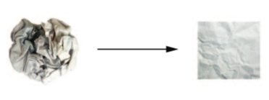
Finding neat representations for complex, highly folded data manifolds.

Slide 15
Lets put the whole process together
Steps for Deep Learning 1 Draw a batch of training samples x and corresponding targets y. 2 Run the network on x (a step called the forward pass) to obtain predictions y_pred. 3 Compute the loss of the network on the batch, a measure of the mismatch between y_pred and y. 4 Update all weights of the network in a way that slightly reduces the loss on this batch.

Slide 16
Step by Step
Step 1 is just putting the data together.
Steps 2 and 3 are merely the application of a handful of tensor operations
Step 4 We learnt yesterday is backpropogation
Lets do all the steps in Keras

